Slide 1

Multiple disease prediction system
Know your chances of getting a disease in just on click

Slide 2
Problem statement
People checking into the hospital face some problems such as appointment of a doctor when the case is emergency . Expecting to get better, some actually wind up getting worse. The Reports like covid-19 and blood platelets can be easily identified but when it comes to the severe diseases like heart, liver and other sensitive organs it is impossible to identify the report by a common person. Therefore the report must be analysed by a specialized Doctor.
So what can you do to know the status of the disease by yourself ?

Slide 3
Solution approach USING MACHINE LEARNING
With the help of Multiple Disease prediction system, Machine learning technology can improve the patient’s experience by providing real-time access to medical knowledge. By providing the suitable correlated parameters it can identify the threat of a disease. So, Finally it states that whether a person is having chances to be effected with a disease or not.

Slide 4
Algorithms used
1.MULTIPLE LINEAR REGRESSION
2.LOGISTIC REGRESSION
3.RANDOM FOREST CLASSIFIER

Slide 5
ML MODELS
HEART DISEASE PREDICTION
KIDNEY DISEASE PREDICTION
DIABETES DISEASE PREDICTION
LIVER DISEASE PREDICTION
CANCER DISEASE PREDICTION

Slide 6
features
Common man can have access to check their health status.
Mobile portability.
Every one can access.
Multiple disease prediction models are hosted.

Slide 7
TECHNOLOGIES USED
MACHINE LEARNING
FLASK
HTML
CSS
BOOTSTRAP
JAVASCRIPT
HEROKU

Slide 8
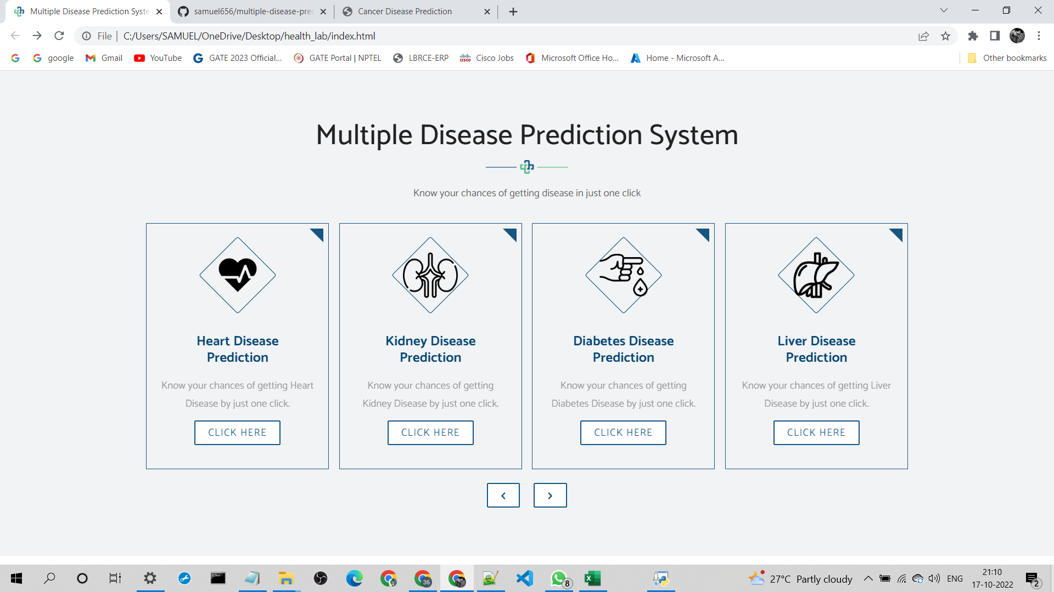
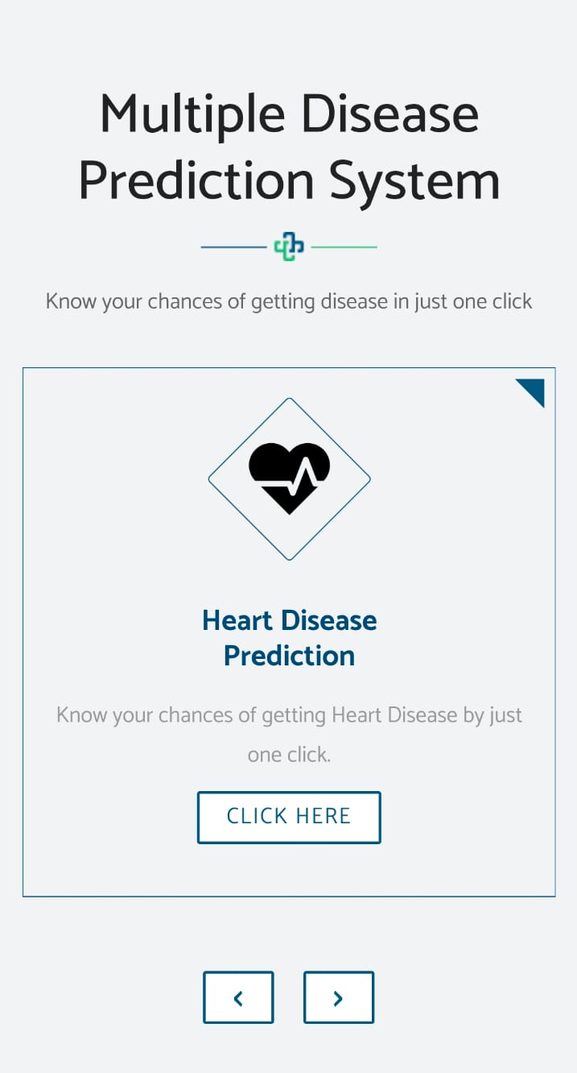
Web api

Slide 9
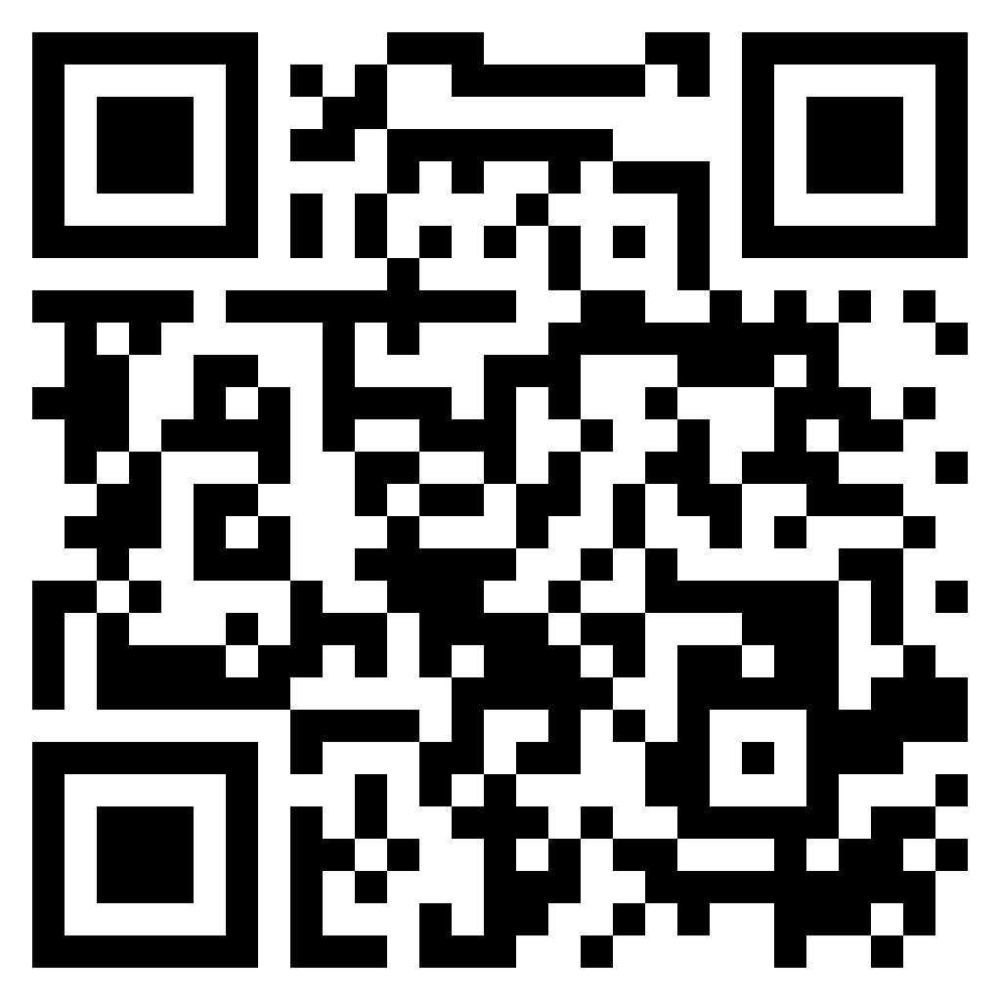
Application details
Know your chances of getting a disease by just one click.
https://multiple-disease-predictions.herokuapp.com
Scan this QR code

Slide 10
TEAM DETAILS
A. Samuel (20761A0565)
A.Venu Reddy (20761A0566)
G. Ganesh Babu (20761A0581)
T. Murali Krishna (20761A05C7)

Slide 11


